Slide 1
Student Depression Prediction
GROUP: 22
Ani Paul
2022-3-60-321
Md Moon Rahman Nayem
2022-3-60-210

Slide 2
27,901 Rows
18 Features
Target Feature Depression
Dataset Description

Slide 3
Checking For Null Values
City: 17
Financial Stress: 03
Dataset Preprocessing
Handle the categorical value with Mapping

Slide 4
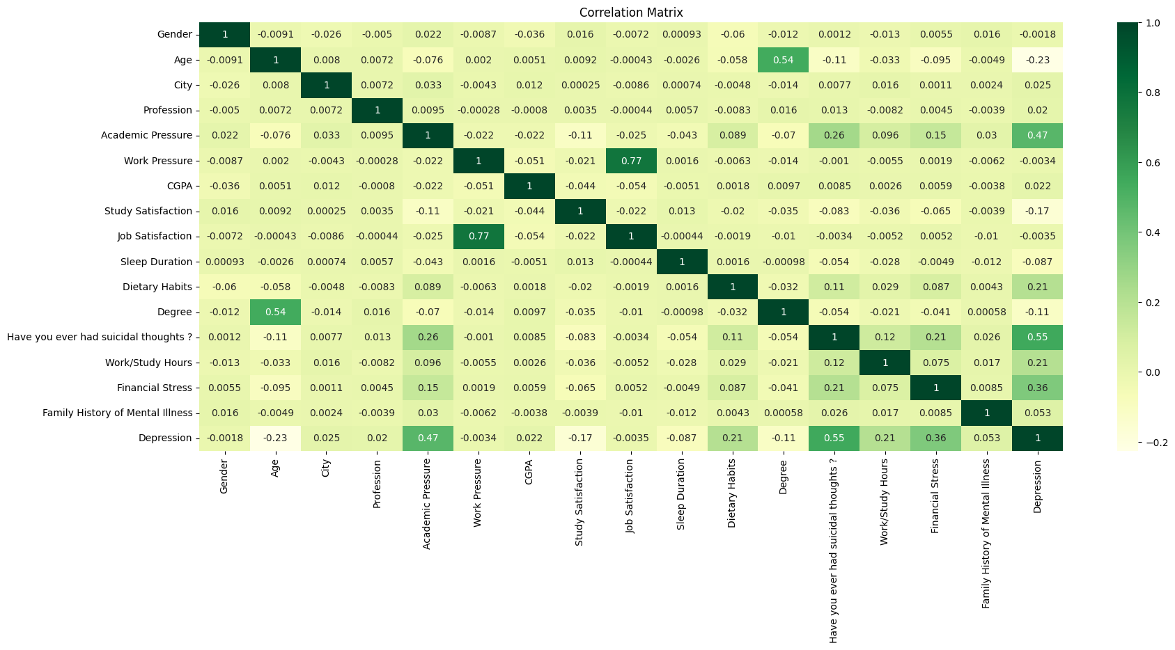
Correlation
Matrix
Strong correlations between: Academic Pressure and Work Pressure (0.77), Study Satisfaction and Job Satisfaction (0.77), Eating Habits and Sleeping Duration (0.89)

Slide 5
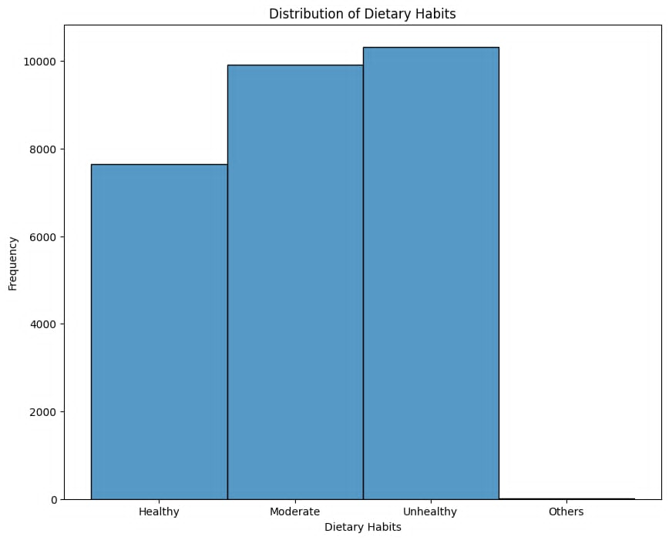

Slide 6
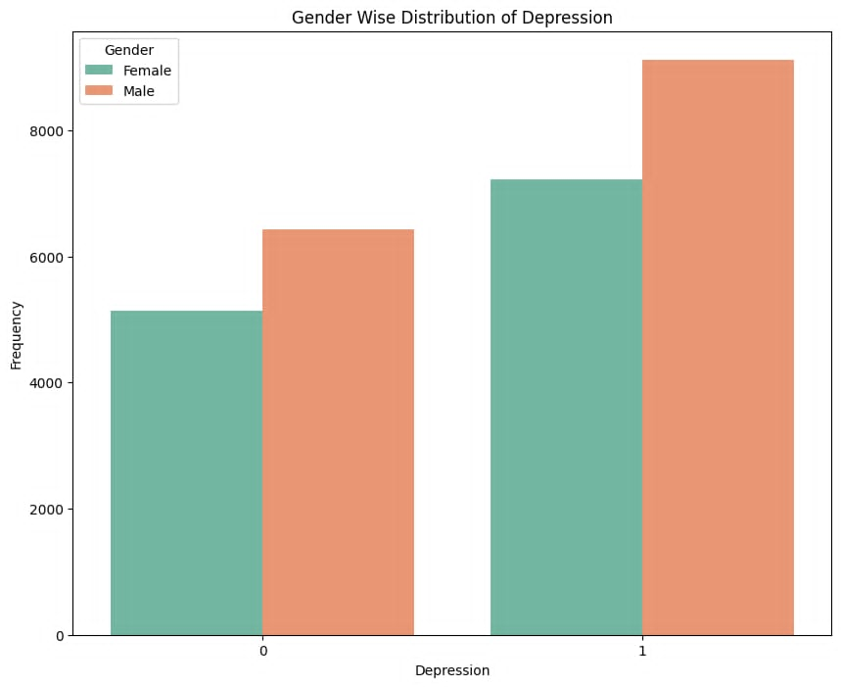
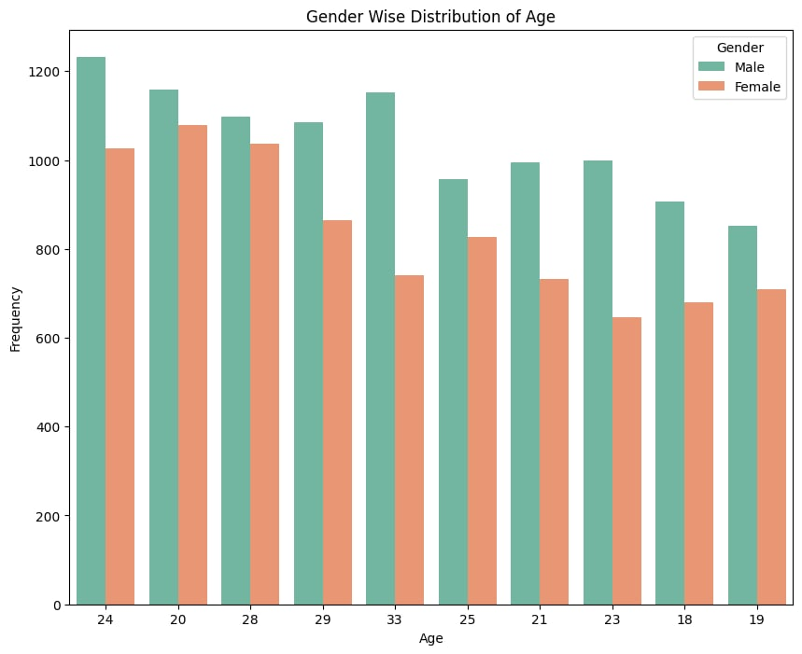

Slide 7
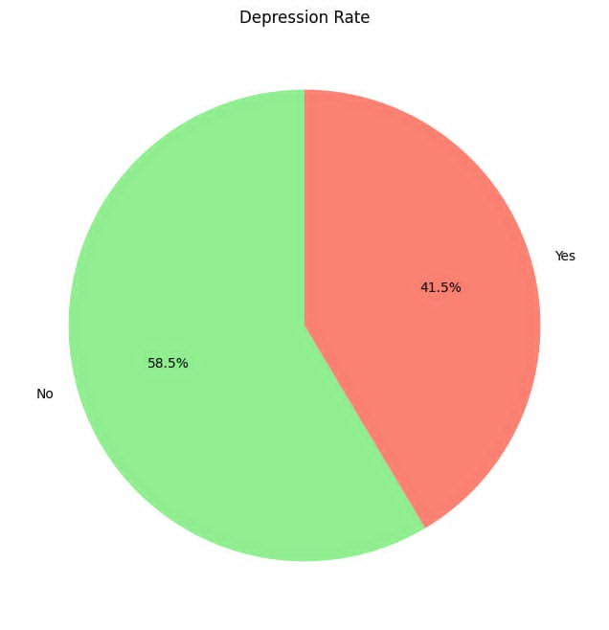
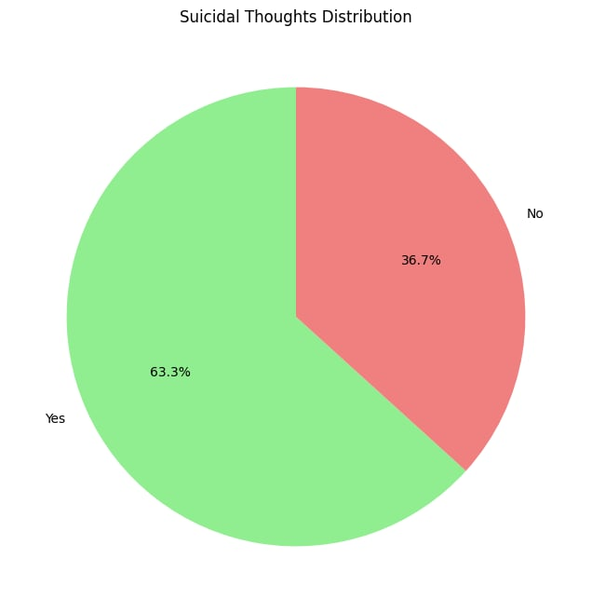

Slide 8
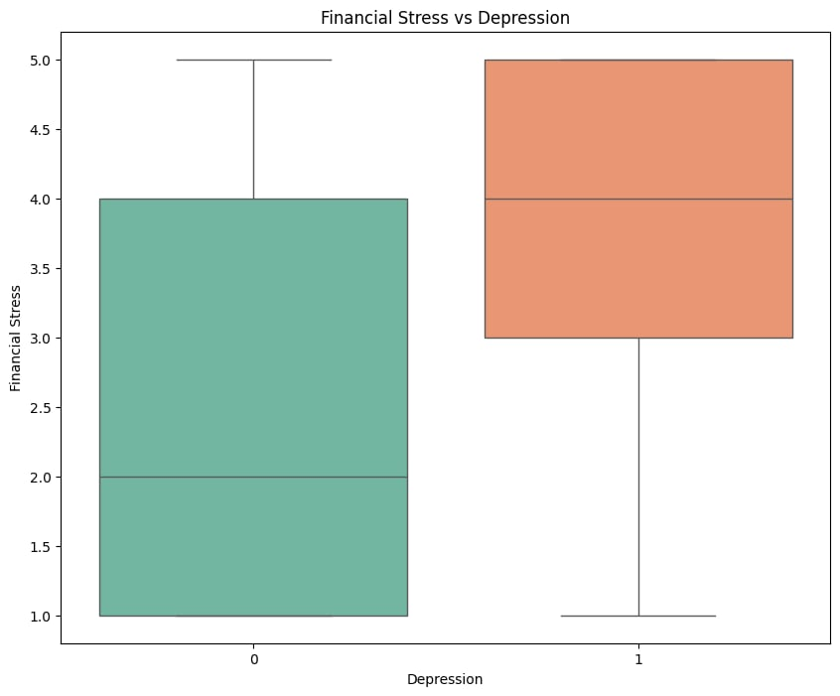
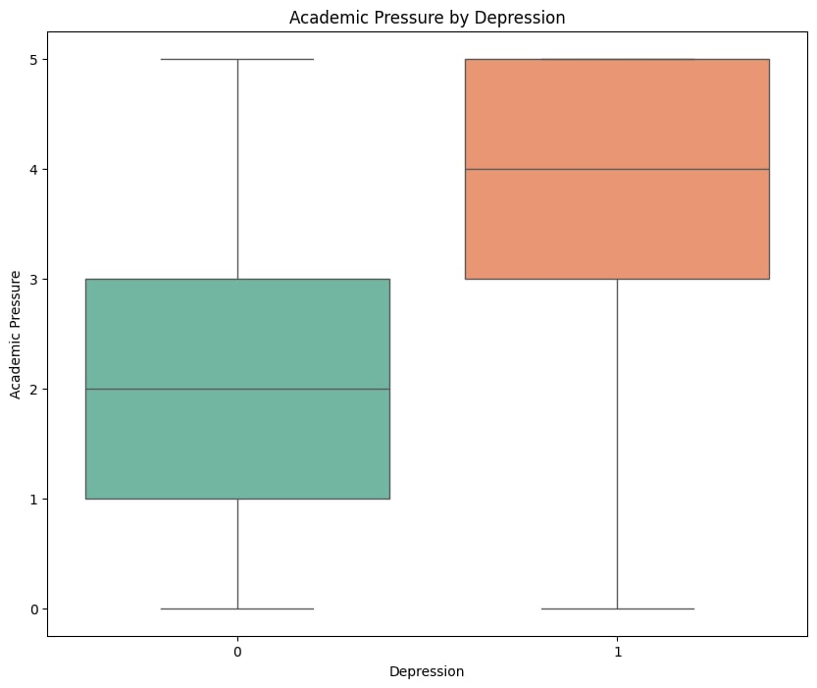

Slide 9
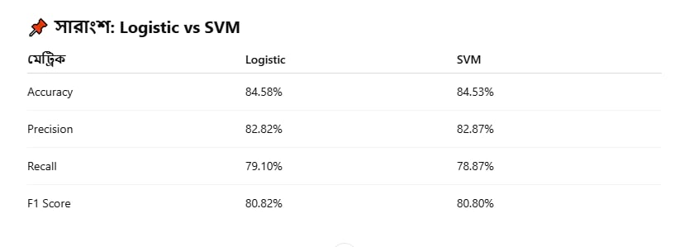
Logistic Regressi0n
SVM
Machine Learning
Model

Slide 10
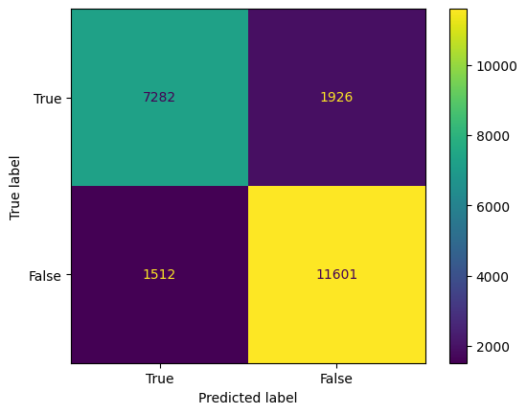
Confusion Matrix-Logistic Regression

Slide 11

Confusion Matrix-SVM

Slide 12
The Logistic Regression is better performance in this dataset. From the evaluation metrics, accuracy, precision, recall, and F1-score also do not make a big difference between Logistic Regression (LR) vs. Support Vector Machine (SVM).
Conclusion

Slide 13
THANK YOU

